Slide 1

Seminar on AI & Technology Innovation
Dr James CHAU
29 July – 31 July 2024

Slide 2
Topic
Wireless IoT Technologies and Applications (29 July 2024)
SoLoMo = Social + Local + Mobile (30 July 2024)
Serving the community with Engineering knowledge (31 July 2024)

Slide 3


Lecturer information
Dr. Chau Chun Pong, James
PhD in Electronic and Information Engineering, PolyU
Principal Lecturer of CPCE, PolyU
Associate Division Head of SEHS, CPCE, PolyU
Research Interests:
Image processing, video processing, pattern recognition, artificial intelligence, Integrated circuits, indoor positioning, robotics.
Tel: 3746 0237
Email: ccjames@cpce-polyu.edu.hk

Slide 4
Day 3: Serving the community with Engineering knowledge
Introduction to engineering development
The social impact of engineering
Case Study

Slide 5

What is Engineering?
https://youtu.be/bipTWWHya8A

Slide 6

Introduction to Engineer Development in Hong Kong
Professional Engineer
Licensed
Accountable for their work
Subscribe to a strict code of ethics and practice standard
Their duty is to serve and protect the public welfare where engineering is concerned
The practice is regulated by professional association

Slide 7

Introduction to Engineer Development in Hong Kong
Hong Kong Institution of Engineers (HKIE)
www.hkie.org.hk
In 1982, the Hong Kong Government's decision to recognise Corporate Members of the HKIE for civil service. Membership in the HKIE is now the primary qualification for employment as a professional engineer in Hong Kong.
In June 1995, the HKIE joined the Washington Accord as one of the signatories. The engineering degrees accredited by the HKIE are recognised by all other signatories including Australia, Canada, Ireland, New Zealand, South Africa, the United Kingdom and the United States.
The Institution assesses and provides accreditation of Hong Kong's engineering degrees and sub-degrees for suitability for educating professional and technician engineers.

Slide 8
Introduction to Engineer Development in Hong Kong
Division of HKIE
Biomedical Division
Building Division
Building Services Division
Civil Division
Control, Automation & Instrumentation Division
Electrical Division
Electronics Division
Environmental Division
Gas & Energy Division
Fire Division
Aircraft Division
Geotechnical Division
Information Technology Division
Manufacturing & Industrial Division
Materials Division
Mechanical, Marine, Naval Architecture & Chemical Division
Nuclear Division
Structural Division

Slide 9
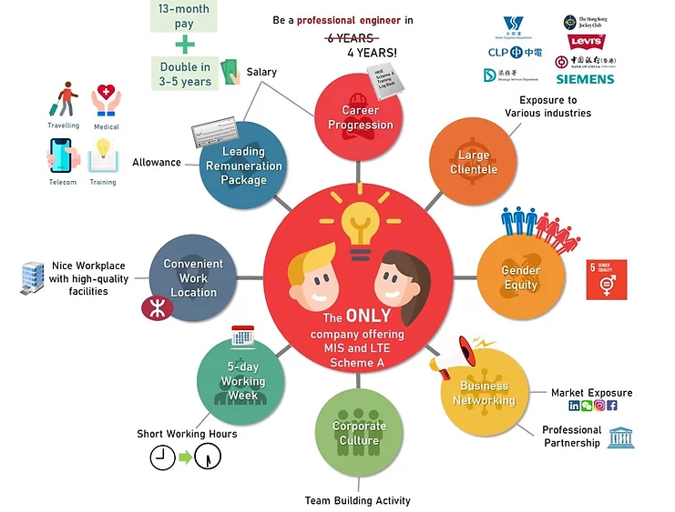
Introduction to Engineer Development in Hong Kong
Training with HKIE
Scheme "A" Training
Provide registered graduate trainees with opportunity
to achieve the necessary reinforcement of theory with practice and
to develop qualities required by a Professional Engineer
Scheme "A" Training covers:
Technical Competence
Managerial & Leadership Abilities
Business Communication Skills
Ethical & Professional Matters
Social Awareness

Slide 10

Introduction to Engineer Development in Hong Kong
Requirements from Scheme “A” Trainees (1)
Graduate Training Log Book
Throughout their training, maintain an ongoing record of their Scheme "A" experiences
Serves as a permanent record of those learned and considered important, e.g., of occurring events, observations and problems identified (and solved)
Serves as continuous measures of the progress which are assessed by the Engineering Supervisor and Tutors
Considered by the interviewers at the Professional Assessment for Corporate Membership
Trainee’s responsibility to follow the style and frequency of submissions required

Slide 11

Introduction to Engineer Development in Hong Kong
Requirements from Scheme “A” Trainees (2)
Continuing Professional Development (CPD) Log Book
For trainees to update depth and breadth of knowledge, and to develop personal qualities
CPD covers matters of direct technical relevance and broader studies, e.g.
Marketing, Legal aspects, Financial management and leadership skills
CPD activity recorded in CPD Log Book and endorsed by the Engineering Supervisor
45 CPD hrs/yr ≤ , for Scheme "A" Training Cert.
Mandatory CPD subjects,
Occupational Safety & Health, 18 hrs ≤
Environmental and related Technological matters, 18 hrs ≤
General and Professional matters, 18 hrs ≤
~ 50% of CPD days to be external to the parent company

Slide 12
Introduction to Engineer Development in Hong Kong
Washington Accord
An international agreement among bodies responsible for accrediting engineering degree programs
Recognizes the substantial equivalency of programs accredited by those bodies and recommends that graduates of programs accredited by any of the signatory bodies be recognized by the other bodies as having met the academic requirements for entry to the practice of engineering

Slide 13
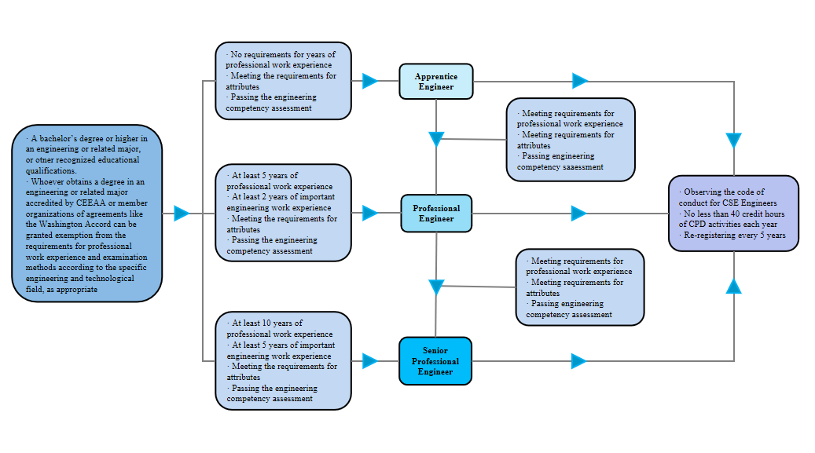
Introduction to Engineer Development in China
Become a professional engineer of the Chinese Society of Engineers (CSE)

Slide 14
The social impact of engineering
The various ways engineering has shaped society in China
Infrastructure development - China has undergone massive infrastructure development in recent decades, including high-speed rail networks, new airports, bridges, roads, power plants, etc. This has helped transform Chinese cities and connect different parts of the country.
Economic growth - China's rapid economic growth has been powered to a large extent by its manufacturing and export-oriented economy, which relies on engineers to design and build factories, machinery, and products.
Urbanization - Hundreds of millions of people have moved from rural to urban areas in China, necessitating the creation of new cities, skyscrapers, subways, and other urban infrastructure engineered by Chinese engineers.

Slide 15
The social impact of engineering
The various ways engineering has shaped society in China
Rising living standards - Engineering advancements in areas like automotive, electronics, appliances, and renewable energy have helped raise Chinese people's living standards.
Military and security - Chinese engineers play an important role in developing the country's military capabilities and technologies, as well as its national surveillance systems.
Environmental challenges - China's severe pollution problems require engineering solutions in areas like alternative energy, emissions control technologies, and wastewater treatment.

Slide 16
The social impact of engineering
The various ways engineering has shaped society in China
National prestige and identity - As China has become an engineering powerhouse, producing cutting-edge technologies in some areas, engineering has become a source of national pride and identity for many Chinese people.
Chinese engineers have been crucial for enabling China's rapid economic growth and modernization in recent decades in addressing future challenges related to sustainable development, resource constraints, aging population, and more.

Slide 17
The social impact of engineering
Examples of socially impactful engineering projects in China
The Three Gorges Dam - The world's largest hydroelectric power station in terms of installed capacity. It provides flood control, electricity generation and navigation along the Yangtze River.
High-speed rail networks - China has the world's largest high-speed rail system with over 35,000 kilometers of track. It has significantly reduced travel times between major cities.
Renewable energy expansion - China is the world leader in installed capacity of renewable energy, especially wind and solar power. This is helping reduce China's heavy reliance on coal.
Urban metro systems - Many Chinese cities have built massive subway networks to help manage traffic congestion and provide public transportation. Beijing, Shanghai and other cities have over 10 lines each.

Slide 18
The social impact of engineering
Examples of socially impactful engineering projects in China
Water diversion projects - China has constructed several mega projects to divert water from the south to the north of the country, alleviating severe water shortages in the northern regions.
Air pollution control - China has implemented various engineering solutions to curb air pollution, including emissions controls on vehicles, desulfurization systems at coal plants and atmospheric dispersion systems in cities.
Rural electrification - China has achieved near-universal access to electricity, even in remote rural villages, through the expansion of power generation and transmission infrastructure.
Smart city and AI initiatives - Chinese cities are investing in Internet of Things technology, energy-efficient buildings, automated systems and AI to improve urban management and citizen services.

Slide 19

How Is China Turning Deserts Into Arable Lands?
In 2016, researchers from China’s Chongqing Jiaotong University claimed to have developed a novel technology that can convert desert to arable land.

Slide 20
Case study: Smart City Development
Blueprint: https://www.smartcity.gov.hk/
Objectives:
make use of innovation and technology to address urban challenges, enhance the effectiveness of city management and improve people’s quality of living as well as Hong Kong’s sustainability, efficiency and safety;
Enhance Hong Kong’s attractiveness to global businesses and talents; and
Inspire continuous city innovation and sustainable economic development
Areas:
Smart Mobility, Smart Living, Smart Environment, Smart People, Smart Government and Smart Economy

Slide 21
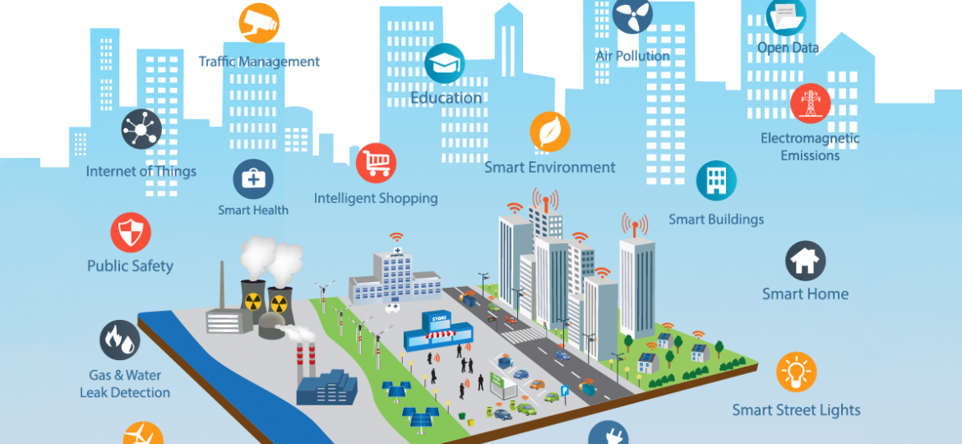
Big Data for a Smart City Infrastructure
What is a Smart City?
An urban area that utilizes advanced technologies, data, and integrated systems to enhance the efficiency, sustainability, and quality of life for its citizens.
Engineers are playing important roles in smart city development.

Slide 22
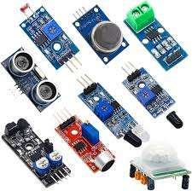
Smart City Infrastructure Fundamentals
Sensor and actuator layer
This is the foundational layer responsible for data collection and response.
It consists of various IoT sensors and devices deployed across the city to gather data on different parameters, such as traffic, air quality, energy usage, water consumption, and more.
Examples include traffic sensors, environmental monitors, smart meters, and surveillance cameras.
These sensors capture real-time data about the city's operations and conditions, and take necessary actions.

Slide 23

Smart City Infrastructure Fundamentals
Network Layer
The network layer is responsible for enabling connectivity and communication between the sensor layer and the upper layers.
It includes the infrastructure and technologies required for data transmission, such as wireless networks (e.g., Wi-Fi, cellular (5G/6G), LoRaWAN), broadband internet, and dedicated communication protocols.
This layer ensures the fast, reliable and secure transfer of data from the sensors to the data processing systems.

Slide 24

Smart City Infrastructure Fundamentals
Data Processing Layer
This layer is responsible for aggregating, storing, and analyzing the data collected by the sensor layer.
It typically includes data centers, cloud computing platforms, and advanced analytics tools.
In this layer, the raw data is processed, transformed, and analyzed using techniques like machine learning, predictive modeling, and data visualization.
The insights and actionable information derived from the data processing layer can then be used to inform decision-making and optimize city operations.

Slide 25
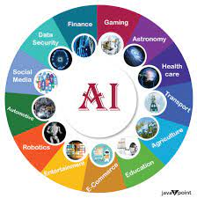
Smart City Infrastructure Fundamentals
Application Layer
The application layer is where the end-user services and smart city applications are implemented.
This layer leverages the data and insights from the lower layers to deliver tangible benefits to citizens, businesses, and city administration.
Examples of applications include smart traffic management, intelligent energy and water distribution, waste management optimization, public safety monitoring, and citizen engagement platforms.
The application layer is the interface through which citizens and city officials interact with and experience the smart city capabilities.

Slide 26

Benefits of Smart City Development
Cost Saving and Increased Asset Value
Smart city technologies can help optimize the usage and maintenance of urban infrastructure, leading to cost savings.
For example, smart street lighting, smart meters, and intelligent traffic management can reduce energy consumption and operational expenses.
Additionally, the data-driven insights generated by smart city systems can help cities make more informed decisions, leading to better asset management and increased asset value over time.

Slide 27

Benefits of Smart City Development
Improved Services and Delivery
Smart city technologies enable more efficient and responsive delivery of public services, such as waste management, public transportation, and emergency response.
Real-time data and automation can help cities identify and address issues more quickly, leading to better service quality and citizen satisfaction.

Slide 28


Benefits of Smart City Development
Decision Making and Citizen Involvement
Smart city platforms provide city leaders and policymakers with data-driven insights to make more informed, evidence-based decisions.
Furthermore, smart city initiatives often include citizen engagement and feedback mechanisms, allowing citizens to actively participate in shaping the city's future.

Slide 29

Benefits of Smart City Development
Quality of Life
Smart city technologies can directly improve the quality of life for citizens by addressing challenges like traffic congestion, air pollution, public safety, and access to public services.
Improved infrastructure, efficient resource management, and enhanced public services contribute to a more livable and sustainable urban environment.

Slide 30

Benefits of Smart City Development
Economic Development
Smart city initiatives can attract businesses, investments, and skilled talent by showcasing a city's technological capabilities and innovative ecosystem.
The adoption of smart city technologies can also lead to the creation of new jobs and industries, fostering economic growth and competitiveness.

Slide 31
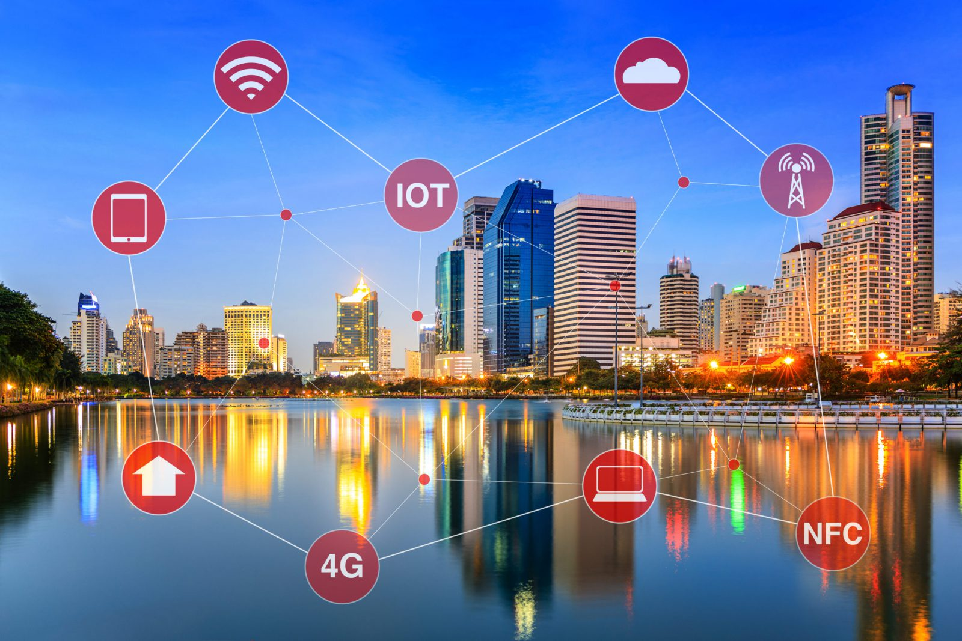
Key Indicators of a Smart City
Smart People
Smart Economy
Smart Governance
Smart Mobility
Smart Environment
Smart Living
How the wireless mobile technology contribute to the key indicators of a Smart City??

Slide 32
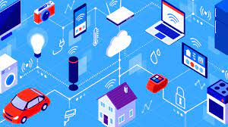
Smart City Technologies
IoT (Internet of Things)
IoT devices and sensors collect real-time data from various city infrastructure and services.
This data is used to monitor, optimize, and automate urban systems like traffic, energy, water, and waste management.

Slide 33

Smart City Technologies
Machine Learning and Data Analytics
Advanced data analysis and predictive modeling techniques are applied to the data collected from IoT devices and other sources.
This enables data-driven decision-making, pattern identification, and the development of smart city applications.

Slide 34

Smart City Technologies
Robotics and Automation
Autonomous robots and automated systems are deployed for tasks like infrastructure maintenance, waste collection, and emergency response in order to reduce the requirement of manpower.
Robotics and automation improve efficiency, safety, and consistency in urban service delivery.

Slide 35

Smart City Technologies
Integrated Command and Control Centers by government
These centralized hubs aggregate and analyze data from various city systems, enabling real-time monitoring, incident management, and coordinated response.
They provide a unified platform for city officials to make informed decisions and respond to urban challenges.

Slide 36
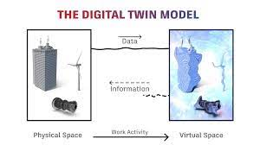
Smart City Technologies
Digital Twin Technology
Digital twins are virtual representations of physical city infrastructure and systems, created using data and simulation models.
They enable scenario planning, predictive maintenance, and the optimization of urban systems.

Slide 37

Smart City Technologies
Blockchain Technology
Blockchain can enhance the security, transparency, and efficiency of various smart city applications, such as energy trading, asset tracking, and citizen identity management.

Slide 38

Smart City Technologies
5G and Edge Computing:
5G networks provide the high-speed, low-latency connectivity required for real-time data processing and the effective deployment of IoT devices.
Edge computing brings data processing and storage closer to the source, reducing latency and improving the responsiveness of smart city applications.

Slide 39
Smart City Infrastructures : Comparison of Hong Kong to Dhaka (Bangladesh)
Hong Kong (Developed City) | Dhaka (Developing City)
Extensive IoT sensor network monitoring traffic, air quality, energy, and public safety | Limited IoT sensor network coverage compared to the country's size and population
Highly advanced 5G and fiber optic communication network | Underdeveloped communication infrastructure, especially in rural and semi-urban areas
Centralized data management and analytics platforms (Smart City Blueprint) | Evolving data management and analytics capabilities at a citywide scale
Intelligent transportation systems (smart traffic lights, real-time monitoring, adaptive routing) | Nascent adoption of intelligent transportation solutions (traffic monitoring and signalling)
Smart grid and renewable energy technologies for improved efficiency and sustainability | Ongoing efforts to improve energy infrastructure and integrate renewable sources

Slide 40
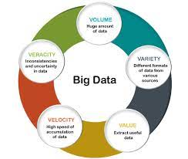
Big Data
Big data refers to the large, complex, and rapidly growing volumes of data that organizations and individuals generate and collect on a regular basis. It is characterized by the following key features:
Volume
large
Variety
Text, images, audio, video, etc.
Velocity
latency
Veracity
Quality and reliability
Value
Revenue generation

Slide 41

Geographic Information Systems(GIS) in Smart City Infrastructures
Data Integration and Centralization
GIS enables the integration and management of diverse spatial data sources, such as sensors, imagery, GPS, and infrastructure information.
This creates a comprehensive and geo-referenced database that serves as the foundation for smart city applications.

Slide 42
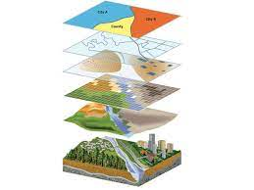
Geographic Information Systems(GIS) in Smart City Infrastructures
Spatial Analysis and Modelling
GIS tools facilitate the identification of patterns, trends, and relationships within spatial data.
This supports a wide range of applications, including traffic management, resource allocation, and infrastructure planning.

Slide 43
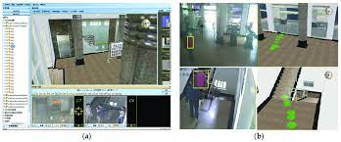
Geographic Information Systems(GIS) in Smart City Infrastructures
Real-time Monitoring and Visualization
GIS platforms display real-time data from sensors and IoT devices, enabling faster decision-making and proactive problem-solving.
Interactive maps, data visualizations, and dashboards provide city officials and citizens with a clear understanding of the city's dynamics.

Slide 44

Geographic Information Systems(GIS) in Smart City Infrastructures
Citizen Engagement and Collaboration
GIS-based tools, such as interactive maps and data reporting platforms, promote transparency and encourage community involvement in urban planning and decision-making.
These tools empower citizens to report issues, provide feedback, and actively participate in shaping their city.

Slide 45
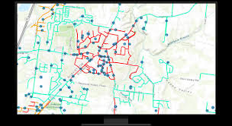
Geographic Information Systems(GIS) in Smart City Infrastructures
Infrastructure and Asset Management
GIS supports the creation of digital inventories and models of physical assets, including roads, buildings, utilities, and other infrastructure.
This enables predictive maintenance, optimization of resource allocation, and coordinated infrastructure upgrades.

Slide 46
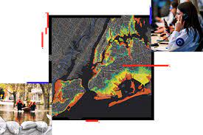
Geographic Information Systems(GIS) in Smart City Infrastructures
Emergency Response and Disaster Management
GIS integrates real-time data from various sources to enhance situational awareness and provide decision support during emergencies and disaster scenarios.
Coordinated emergency response and efficient recovery efforts are facilitated through the use of GIS-powered mapping and analysis tools.

Slide 47

Application: Smart Buildings and the Environment
Occupancy Tracking and Monitoring
Space Utilization Optimization
Asset and Equipment Tracking
Building Analytics and Reporting

Slide 48
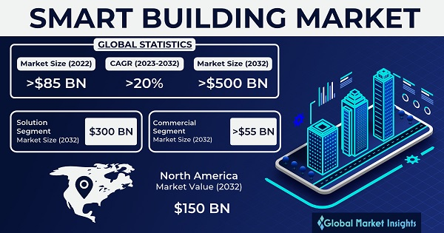
Application: Smart Buildings and Commercial Activity
Real time building information to occupants
Personalization
Reduce energy consumption
Product and service promotion

Slide 49

Application: Smart Buildings and Pedestrian Traffic
Pedestrian-Centric Design
Wayfinding and Navigation
Crowd Management and Flow Optimization
Integration with Transportation Systems

Slide 50




Barrier free navigation
It refers to the design and implementation of environments, websites, and digital interfaces that are accessible to all individuals, including those with disabilities.
The goal is to remove obstacles that might prevent someone from fully accessing or using the content and services provided.

Slide 51

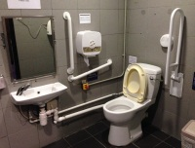
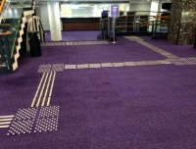
Barrier free navigation
Key Principles
Universal design: environment assessed by all types of user
Equitable use: identical use of the design
Flexibility in use: wide range of functions to serve different user
Simple and intuitive use: easy to use
Safe and reliable

Slide 52

Barrier free navigation
Anything that can improve?
According to the blind people, it is difficult for them to explore new places without their accompanies as they do not know their surroundings in the new environment
As a result, digital map with barrier free navigation function is the solution
It avoids the path with stair, escalator, etc in the paths.
Citygeni apps

Slide 53
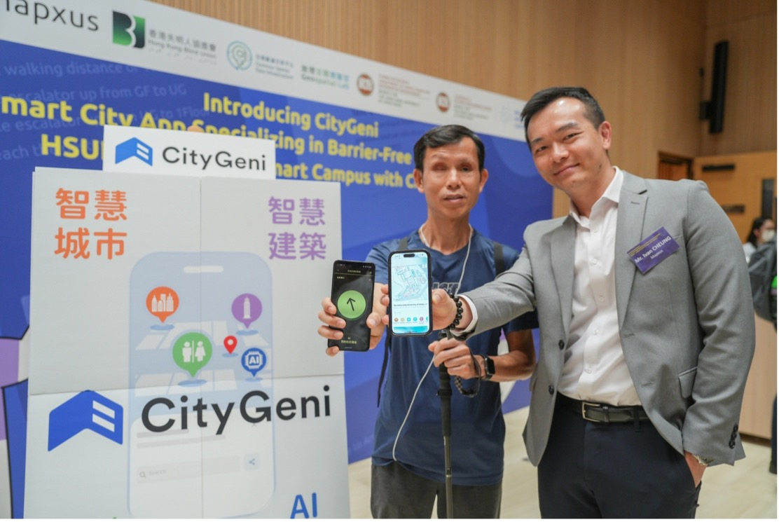
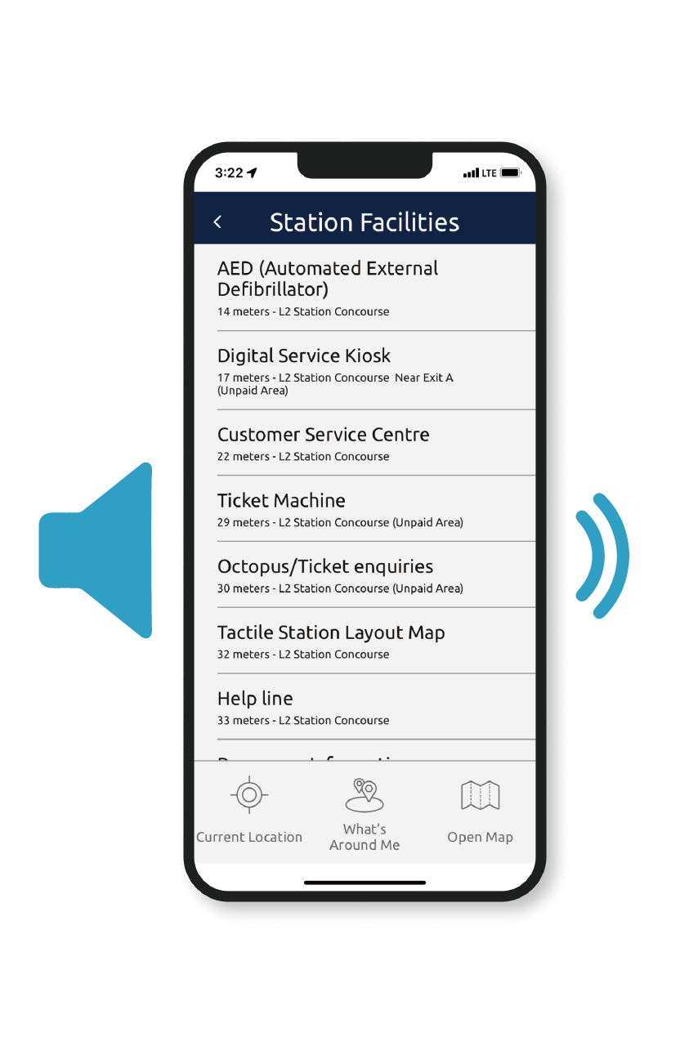

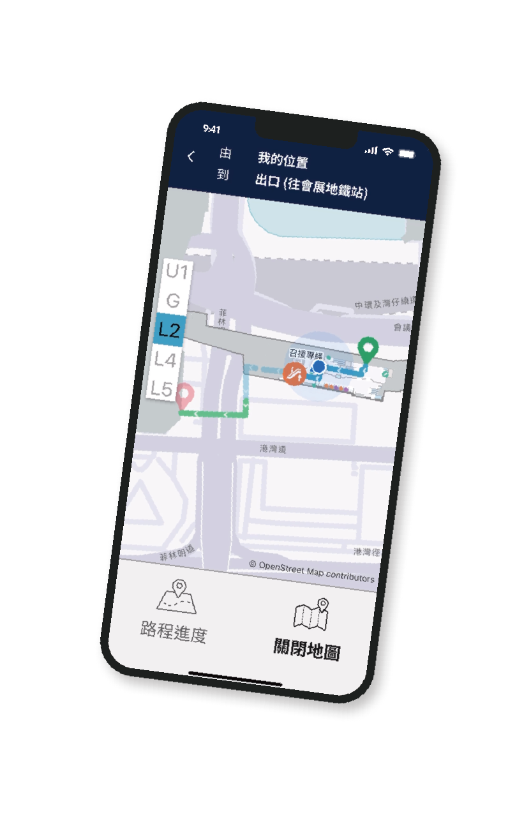
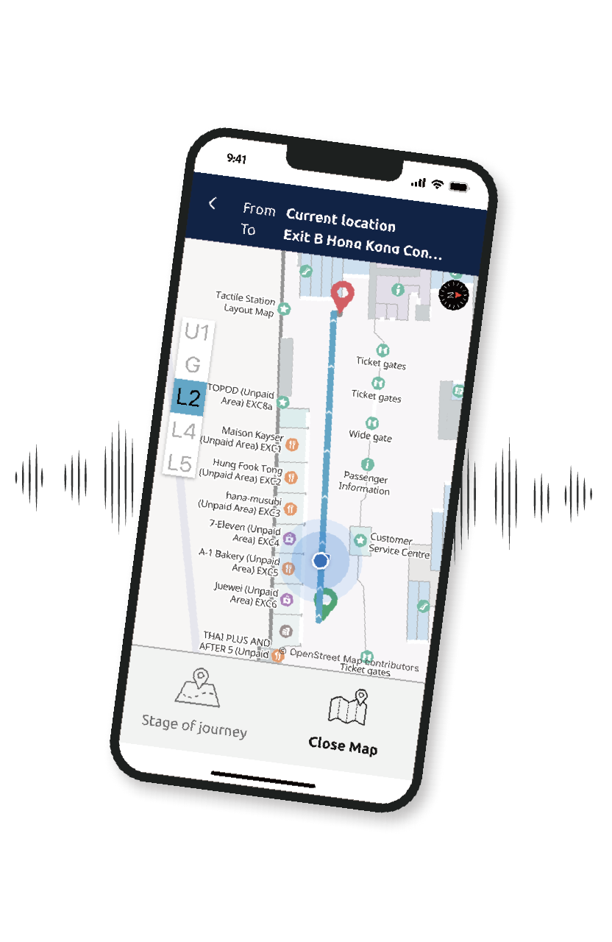

Slide 54
Technology behind
Mobile technology
Digital map
Positioning and path findings in outdoor and indoor environment
Voice recognition
Voice synthesis

Slide 55

Demonstration
https://youtu.be/o2Ja3uX2j7Y

Slide 56

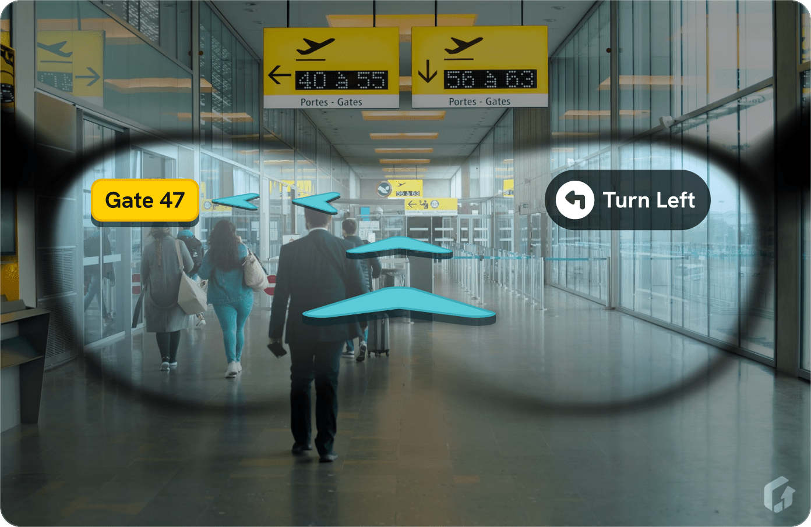
What is next?
AI and AR Smart Glasses for environment navigation

Slide 57

Smart glasses functions
Augmented Reality (AR) overlays
Hands-free interaction
Real-time translation
Navigation assistance
Health and fitness tracking
Notifications and alerts
Object and voice recognitions

Slide 58
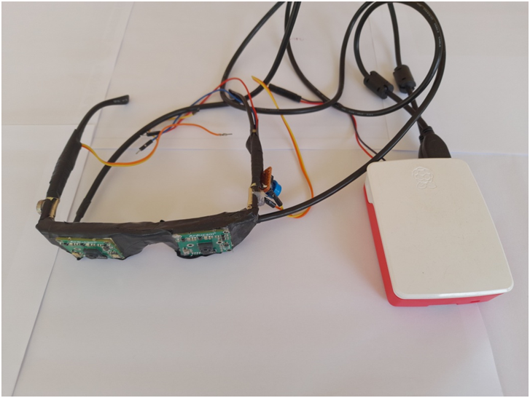
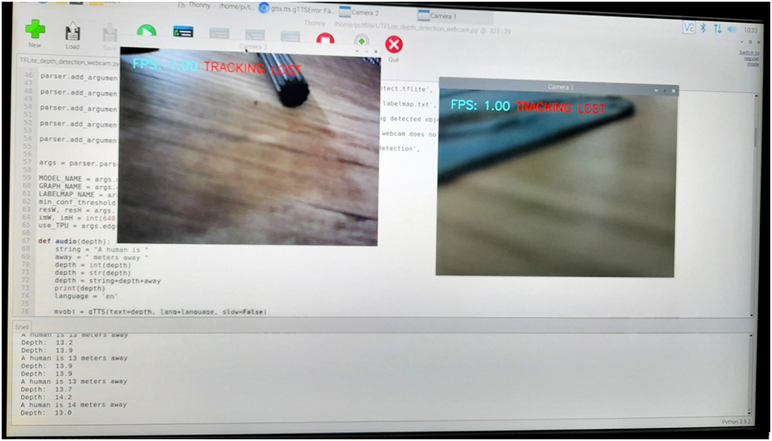
A pilot project of smart glasses for blind people
Smart-glass-for-blind-people-using-raspberry-pi
https://github.com/pro3088/Smart-glass-for-blind-people-using-raspberry-pi

Slide 59
Summary
Introduction to engineering development
The social impact of engineering
Case study

Slide 60
Thank you…
Through these 3-day seminars, hope that you can enjoy them, know the ways to move forwards and prepare yourselves for future challenges!

